Slide 1
ALL GENES
Identify pollen specific genes
HRGPs
Non HRGPs
Background HRGPs
AGP
EXT
Motif discovery
Do they appear in other pollen specific genes?
Are they conserved?
Motifs
What biological functions do they have?
What known TFBS do they match?

Slide 2
ALL GENES
Identify pollen specific genes
Isaac
Rich
HRGPs
Non HRGPs
Background HRGPs
AGP
EXT
Motif discovery
Do they appear in other pollen specific genes?
Prashant
Prashant
Prashant
Are they conserved?
Motifs
Prashant
What biological functions do they have?
Prashant
What known TFBS do they match?

Slide 3
ALL GENES
RNA-seq
Evidence
Isaac
Table 1. Tissue Specification of 166 HRGPs
Table S1. Pollen Specific non-HRGPs.
Tau > 0.85
Identify pollen specific genes
Table 2. Common promoter elements for pollen specific HRGPs
Mean log2(exp) = 0
Table 3. Motif database
Table 4. Statistical significant biological functions
HRGPs
Non HRGPs
Background HRGPs
AGP
EXT
Motif discovery
Do they appear in other pollen specific genes?
Prashant
Phylogenetic tree?
Prashant
Prashant
Are they conserved?
Motifs
Prashant
What biological functions do they have?
Prashant
What known TFBS do they match?

Slide 4
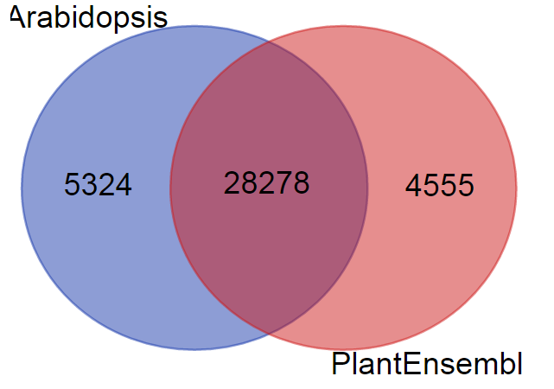
There is a difference in the number of genes in Arabidopsis.org and Ensembl Biomart

